Slide 1
EAHC-MSDIWG1 Report
IHO MSDIWG10
Busan, ROK
4-6 March 2019
Presented by Mr.Jun-Shik Lee
Notes:
Good morning everyone,
My name is Jun-shik Lee of khoa, on behalf of the Chair of EAHC-MSDI Working Group.
I’d like to present the 1st EAHC MSDIWG meeting report.

Slide 2
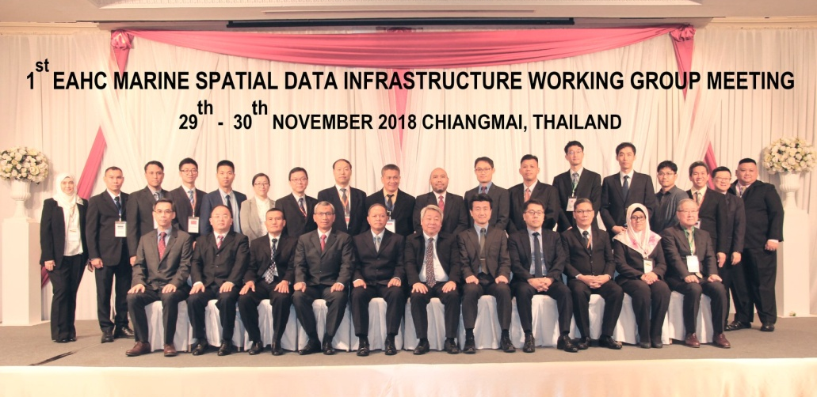
01
1st EAHC-MSDIWG Meeting
Meeting place
The 1st EAHC-MSDIWG meeting was held in Chiang Mai, Thailand in November 2018.
Participants
30 participants from 9 countries (Brunei Darussalam, China, Japan, Indonesia, Singapore, Republic of Korea, Malaysia, Philippines, Thailand)
Main Agenda
EAHC-MSDIWG Progress and TOR
Country Reports on National MSDI
MSDI Concept and Importance
MSDI Trend Report
WG Work Plan
Notes:
The 1st EAHC-MSDIWG meeting was held in Chiang Mai, Thailand in November 2018.
30 participants from 9 member states attended.
Mainly 5 agenda items were discussed at the meeting.
The meeting discussed EAHC-MSDI WG Progress and TOR, Country reports on MSDI, MSDI concept and importance, MSDI trend report, and WG work plan.

Slide 3
02
EAHC-MSDIWG Progress
Membership
Nation | Position | Name
Republic of Korea | Chair | Dr. Jung Hyun KIM
Japan | Vice-Chair | -
Republic of Korea | Member | Mr. Jun-Shik LEE
Philippines | Member | Lt. Romel Correa
Indonesia | Member | Cdr. Qisthi Amarona
 | Member | Lt. Andry Novianto
Japan | Member | Mr. Takeharu Miyake
Thailand | Member | Cdr. Rachot Osiri
China | Member | Mr. Dongli Sun
Brunei Darussalam | Member | Mr. Abdul Malik Hj Abdul Hamid
Malaysia | Member | Cdr. Kamaruddin bin Yusof
Singapore | Member | Mr. Jamie Chen
DPRK |  | -
Notes:
It was the first working group meeting, so the membership was reviewed.
All member states have a member in the working group except the North korea.

Slide 4
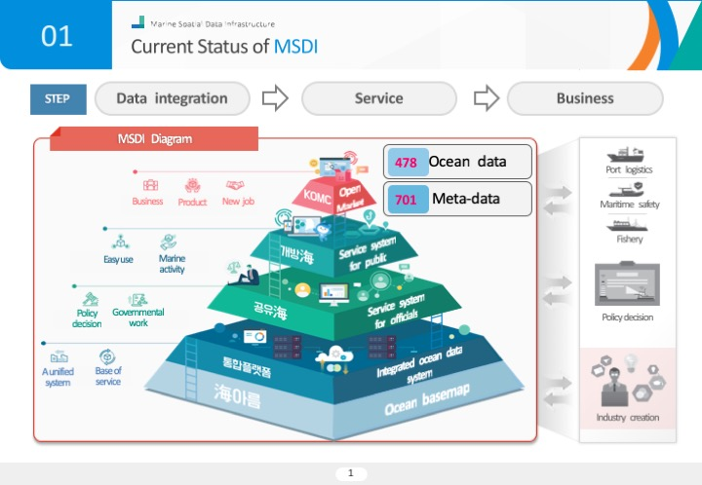
03
Country Reports on National MSDI [1/2]
MSDI Country Report
Brunei
Japan
ROK
Notes:
For the country report, five member states, Brunei, Japan, ROK, Singapore and Malaysia, presented their country reports on national MSDI.
Brunei introduced its Survey Spatial Data Infrastructure because they didn’t have MSDI.
Japan developed New Web-GIS service called MSIL, where real time WebGIS would be part of the Japan’s Maritime Domain Awareness.
Japan will share its experience on data harmonization and interoperability at the next Working Group meeting.
ROK presented the status of MSDI. ROK integrates and provides Marine spatial information within the Ministry of Oceans and Fisheries.

Slide 5
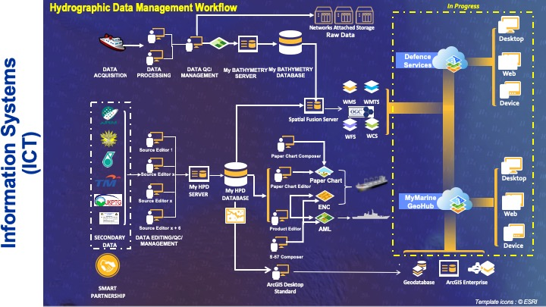
03
Country Reports on National MSDI [2/2]
MSDI Country Report
Singapore
Malaysia
Notes:
Singapore presented a single integrated data platform “GeoSpace-Sea” for seamless access to quality marine information for various national projects.
Finally, Malaysia explained its involvement on marine spatial infrastructure in Malaysia.

Slide 6
04
MSDI Concept and Importance
Marine SDI
Functions
Environmental protection and regional marine planning
Offshore oil, gas and minerals exploration and industry
Submarine cable and pipeline protection
Defense, border protection and customs
Transport and post security
Fisheries management
Indigenous interests
Maritime safety
Standards
User
Policies
ISO 19115-Metadata
ISO 19119-Services
ISO 19127-Geodecy
ISO 19128-WMS
ISO 19136-GML
ISO 19138-Quality
ISO 19139-Metadata
Web Browser
Legislation
IMO
IHO
UNCLOS
MARPOL
Proposed Solution
OGC Services
Metadata and Data
Data Custodians
5
Notes:
Next, we shared information on the concept and importance of MSDI at the meeting.
We looked at why we need to establish marine spatial data infrastructure.
The major issues can be grouped by standards, user, and policies.
The meeting enhanced that MSDI can provide effective marine and coastal management to meet the economic, social and environmental objectives of sustainable development.

Slide 7
05
MSDI Trends Report [1/3]
IHO MSDI WG
Support the activities of the IHO related to Spatial Data Infrastructures (SDI) and/or Marine Spatial Data Infrastructures (MSDI)
UN-GGIM WGMGI
UN-GGIM WGMGI was established in 2017
Strengthening substantive issues on marine environment
Supporting the availability and accessibility of comprehensive location-based information in helping Member States
Arctic SDI Portal
ARHC 5th Meeting Action: Denmark and U.S. to propose a regional approach to MSDI.
Facilitating access to geospatial information over the entire Arctic
Notes:
Furthermore, the meeting reviewed the international MSDI trends.
Firstly, we looked at the IHO MSDIWG. We shared the role and functionalities of it.
Next, we informed each member of the establishment of UN-GGIM WG on MGI and shared the working group’s objectives and activities.
Finally, we introduced Arctic MSDI WG. The Arctic MSDI WG may be the EAHC MSDIWG’s role model.
Arctic MSDI facilitates access to geospatial information over the entire Arctic to support social, economic, environmental, monitoring and decision-making in the Arctic. We looked through the Arctic MSDI portal.
회원국은 IHO MSDIWG에서 지역수로위원회 MSDIWG 활동을 모니터링하고 있는지 질문했고,
한국은 IHO MSDIWG이 지역수로위원회 활동에 매우 관심을 가지고 있으며 매년 보고해 주기를 바란다고 답변하였다.
The member states asked if IHO MSDIWG is monitoring the activities of the regional hydrographic commission and RoK replied that iho msdiwg is very interested in the activities of the regional hydrographic commission and hopes Rok to report them annually.

Slide 8
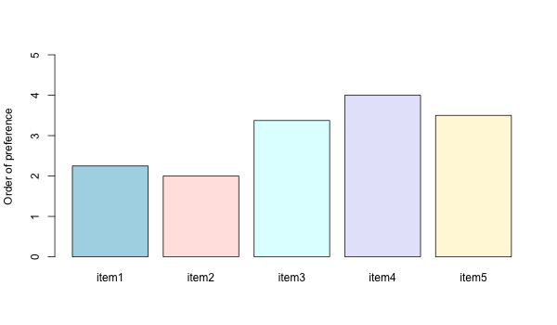
06
WG Workplan [1/2]
Please indicate which tasks should be first dealt with at the WG
by marking 1 to 5 in the brackets in order of importance, 1 being the highest.
Item 1: Develop a roadmap for the EAHC.
Item 2: Identify user’s needs and end user applications.
Item 3: Governance structure to coordinate work, data standards, applications, etc.
Item 4: Draft guidelines for developing national MSDIs.
Item 5: Capacity building.
Identify user’s needs and end user applications
Develop a roadmap
for the EAHC
Governance structure to coordinate work, data standards, applications, etc.
Capacity building
Draft guidelines for developing national MSDIs.
9
Notes:
Prior to the 1st EAHC-MSDIWG meeting, ROK distributed a questionnaire to MSs to identify the status, requirements and future role of the WG.
There are nine questions in the questionnaire and I received responses from 8 countries.
For example, this slide shows one of questions which asks each member to indicate the priority of tasks.
The response was used to make a work plan in the next slide.

Slide 9
06
WG Workplan [2/2]
EAHC-MSDIWG Work Plan
Task A (Leadership and coordination)
Task B (Operational data sharing and management)
Task C (Policies and governances)
Task D (Standards)
Task E (Training and education)
Notes:
The work plan was drafted based on the IHO MSDIWG work plan.
It has five parts: Leadership and Coordination, Operational – Data Sharing and Management, Policies and Governances, Standards, and Training and Education.
There was detailed discussion, but the meeting was closed without finalizing it.
Later the chair made some amendments to it and circulated it to MSs by correspondence. And it will be finalized in the 2nd working group meeting.
We will be able to share the finalized EAHC-MSDIWG workplan next year.

Slide 10
07
Challenges & Future meeting
Challenges
It is difficult to find common interests because each member has a different level of understanding and requirements for EAHC MSDI.
Some responsible organizations for MSDI have unique constraints (e.g., sharing marine geospatial data or leading the role of the national MSDI)
Developing use case exercises to offer benefits of EAHC MSDI to each member.
2nd Meeting of the EAHC-MSDIWG
June 2019, Singapore
Notes:
Let’s move on the challenges and next meeting of EAHC MSDIWG.
There are broadly two difficulties.
First, It is difficult to find common interests because each member has a different level of understanding and requirements for EAHC MSDI. Each country of EAHC MSDIWG is very largely spatially distributed. It is harder to pursue one common goal.
Next, Some responsible organizations for MSDI have unique constraints. For example, it is very difficult to share marine geospatial data. Or some organizations has not the leading role of the national MSDI, which leads to the difficulty of reaching consensus.
Thus we are developing use case exercises to provide benefits of EAHC MSDI to each member.
These activities can promote the participation of member countries in their activities.
Finally, I would like to inform that 2nd EAHC MSDIWG meeting will be held June, this year, Singapore.
That’s all for me.

Slide 11
Thank you
Notes:
Thank you for your attention.

